Slide 1

Technologies enabling cloud computing

Slide 2
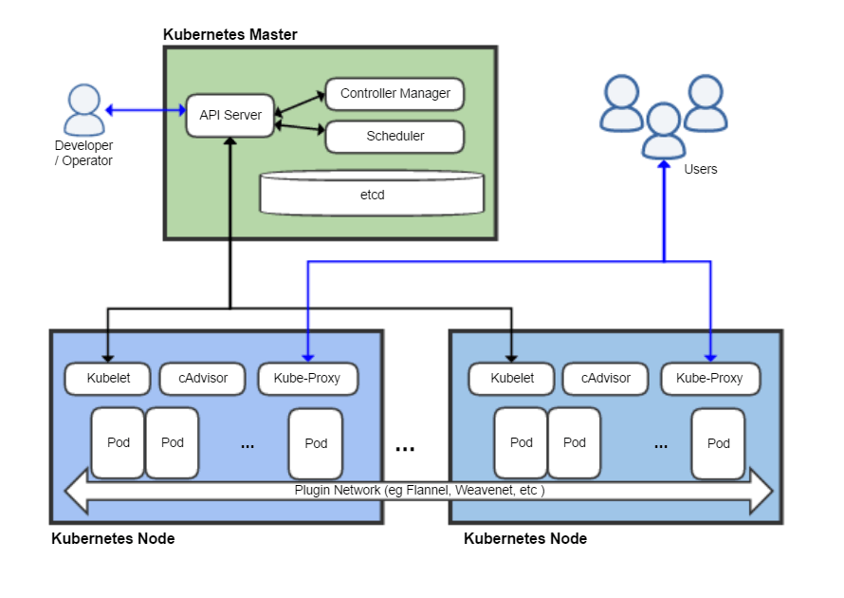
Kubernetes architecture

Slide 3
Example - CERN core technologies running in containers
Container-based Service Deployment
Containerize and distribute CERN storage services and deploy them on any cloud
CERN - the European Organization for Nuclear Research
a European research organization that operates the largest particle physics laboratory in the world
ScienceBox
The container-based version of CERN services
EOS
CERNBox
SWAN

Slide 4



Containerized CERN Technology
Boxed – Scalable Storage Backend for Cloud and HPC (high performance computing)
- Self-contained, Docker-based package with:
EOS: Disk Storage for LHC+physics data, and CERNBox
CERNBox: Cloud Sync&Share for Science
SWAN: Platform for Interactive Data Analysis in the Cloud
CERN IT-ST
CERN IT-ST
CERN IT-ST + EP-SFT

Slide 5

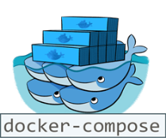




Containerized CERN Technology
ScienceBox – Self-contained, Docker-based package with:
+
+
One-Click Demo Deployment
Production-oriented Deployment
Single-box installation via docker-compose
No configuration required
Download and run services in 15 minutes
https://github.com/sciencebox
Container orchestration with Kubernetes
Scale-out storage and computing
Tolerant to node failure for high-availability

Slide 6

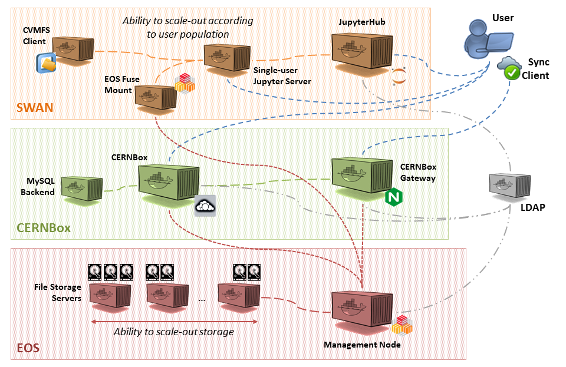


ScienceBox Architecture
SWAN: Platform for Interactive Data Analysis in the Cloud
CERNBox: Cloud Sync&Share for Science
EOS: Disk Storage for LHC+physics data, and CERNBox
https://sciencebox.web.cern.ch/sciencebox/

Slide 7





Use Cases for ScienceBox
EU Project Up to University (Up2U)
Simplified try-out and deployment for peers
Australia's Academic and Research Network (AARNET)
Joint Research Centre (JRC), Italy
Saint Petersburg State University, Russia
National Research Center “Kurchatov Institute”, Russia
Disposable deployment for testing and development within IT-ST and EP-SFT groups at CERN

Slide 8






Deployment on Private and Public Clouds
Single-box deployment running on multiple clouds:
Amazon Web Services
Helix Nebula Cloud (IBM, RHEA, T-Systems)
OpenStack Clouds (CERN, GRNet, PSNC)
Your own laptop! (CentOS, Ubuntu)
Production-oriented deployment with Kubernetes
OpenStack at CERN
Poznań Supercomputing and Networking Center (PSNC)

Slide 9
Cloud computing technologies
Virtualization
Load balancing
Programming models
Cloud storage

Slide 10
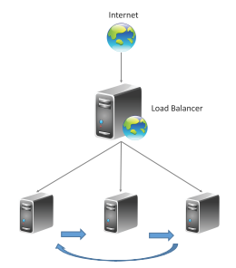
Load Balancing
Cloud computing resources can be scaled up on demand to meet the performance requirements of applications.
Load balancing distributes workloads across multiple servers to meet the application workloads.
The goals of load balancing techniques include:
Achieve maximum utilization of resources
Minimizing the response times
Maximizing throughput

Slide 11
How does load balancing work?
Companies usually have their application running on multiple servers
Such a server arrangement is called a server farm
User requests to the application first go to the load balancer
The load balancer then routes each request to a single server in the server farm best suited to handle the request

Slide 12
Load balancing types
Depending on what the load balancer checks in the client request to redirect the traffic
Application load balancing
Network load balancing
Global server load balancing
DNS load balancing

Slide 13
Application load balancing
Complex modern applications have several server farms with multiple servers dedicated to a single application function.
Application load balancers look at the request content, such as HTTP headers or SSL session IDs, to redirect traffic.
For example, an ecommerce application has a product directory, shopping cart, and checkout functions
The application load balancer sends requests for browsing products to servers that contain images and videos but do not need to maintain open connections
The application load balancer sends shopping cart requests to servers that can maintain many client connections and save cart data for a long time

Slide 14
Network load balancing
Network load balancers examine IP addresses and other network information to redirect traffic optimally.
They track the source of the application traffic and can assign a static IP address to several servers.
Network load balancers use the static and dynamic load balancing algorithms to balance server load.

Slide 15
Global server load balancing
Global server load balancing occurs across several geographically distributed servers.
For example, companies can have servers in multiple data centers, in different countries, and in third-party cloud providers around the globe.
In this case, local load balancers manage the application load within a region or zone.
They attempt to redirect traffic to a server destination that is geographically closer to the client.
They might redirect traffic to servers outside the client’s geographic zone only in case of server failure.

Slide 16
DNS load balancing
In DNS load balancing, you configure your domain to route network requests across a pool of resources on your domain.
A domain can correspond to a website, a mail system, a print server, or another service that is made accessible through the internet.
DNS load balancing is helpful for maintaining application availability and balancing network traffic across a globally distributed pool of resources.

Slide 17
Load balancing technologies
A load balancer
a software or hardware device that keeps any one server from becoming overloaded
A load balancing algorithm
the logic that a load balancer uses to distribute network traffic between servers (an algorithm is a set of predefined rules

Slide 18
Load balancers
Hardware load balancers
A hardware-based load balancer is a hardware appliance that can securely process and redirect gigabytes of traffic to hundreds of different servers. You can store it in your data centers and use virtualization to create multiple digital or virtual load balancers that you can centrally manage.
Software load balancers
Software-based load balancers are applications that perform all load balancing functions. You can install them on any server or access them as a fully managed third-party service.

Slide 19
Hardware load balancers vs Software load balancers
Hardware load balancers require an initial investment, configuration, and ongoing maintenance
You might also not use them to full capacity, especially if you purchase one only to handle peak-time traffic spikes
If traffic volume increases suddenly beyond its current capacity, this will affect users until you can purchase and set up another load balancer
Software-based load balancers are much more flexible
They can scale up or down easily and are more compatible with modern cloud computing environments.
They also cost less to set up, manage, and use over time

Slide 20
Load balancing approaches
Dynamic load balancing
uses algorithms that take into account the current state of each server and distribute traffic accordingly
Static load balancing
distributes traffic without making these adjustments
some static algorithms send an equal amount of traffic to each server in a group, either in a specified order or at random

Slide 21
Dynamic load balancing algorithms
Least connection:
Checks which servers have the fewest connections open at the time and sends traffic to those servers. This assumes all connections require roughly equal processing power.
Weighted least connection:
Gives administrators the ability to assign different weights to each server, assuming that some servers can handle more connections than others.
Weighted response time:
Averages the response time of each server, and combines that with the number of connections each server has open to determine where to send traffic. By sending traffic to the servers with the quickest response time, the algorithm ensures faster service for users.
Resource-based:
Distributes load based on what resources each server has available at the time. Specialized software (called an "agent") running on each server measures that server's available CPU and memory, and the load balancer queries the agent before distributing traffic to that server.

Slide 22
Static load balancing algorithms
Round robin:
Round robin load balancing distributes traffic to a list of servers in rotation using the Domain Name System (DNS). An authoritative nameserver will have a list of different A records for a domain and provides a different one in response to each DNS query.
Weighted round robin:
Allows an administrator to assign different weights to each server. Servers deemed able to handle more traffic will receive slightly more. Weighting can be configured within DNS records.
IP hash:
Combines incoming traffic's source and destination IP addresses and uses a mathematical function to convert it into a hash. Based on the hash, the connection is assigned to a specific server.

Slide 23
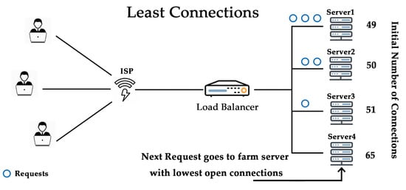
Least connection
Checks which servers have the fewest connections open at the time and sends traffic to those servers
This assumes all connections require roughly equal processing power

Slide 24
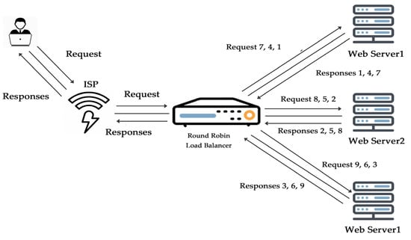
Round robin
Round robin load balancing distributes traffic to a list of servers in rotation using the Domain Name System (DNS)
An authoritative nameserver will have a list of different A records for a domain and provides a different one in response to each DNS query

Slide 25
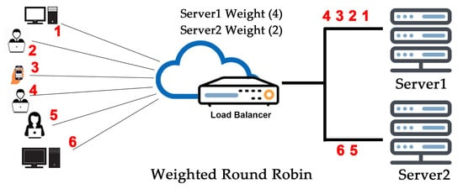
Weighted round robin
Allows an administrator to assign different weights to each server
Servers deemed able to handle more traffic will receive slightly more
Weighting can be configured within DNS records

Slide 26
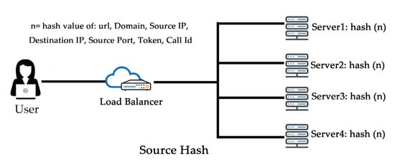
IP hash
Combines incoming traffic's source and destination IP addresses and uses a mathematical function to convert it into a hash. Based on the hash, the connection is assigned to a specific server

Slide 27
Load balancing benefits
Application availability
Application scalability
Application security
Application performance

Slide 28
Application availability
Server failure or maintenance can increase application downtime, making the application unavailable to visitors.
Load balancers increase the fault tolerance of systems by automatically detecting server problems and redirecting client traffic to available servers.
Load balancing can be used to make these tasks easier:
Run application server maintenance or upgrades without application downtime
Provide automatic disaster recovery to backup sites
Perform health checks and prevent issues that can cause downtime

Slide 29
Application scalability
You can use load balancers to direct network traffic intelligently among multiple servers.
Your applications can handle thousands of client requests because load balancing does the following:
Prevents traffic bottlenecks at any one server
Predicts application traffic so that you can add or remove different servers, if needed
Adds redundancy to your system so that you can scale with confidence

Slide 30
Application security
Load balancers come with built-in security features to add another layer of security to your internet applications. They are a useful tool to deal with distributed denial of service attacks, in which attackers flood an application server with millions of concurrent requests that cause server failure. Load balancers can also do the following:
Monitor traffic and block malicious content
Automatically redirect attack traffic to multiple backend servers to minimize impact
Route traffic through a group of network firewalls for additional security

Slide 31
Application performance
Load balancers improve application performance by increasing response time and reducing network latency. They perform several critical tasks such as the following:
Distribute the load evenly between servers to improve application performance
Redirect client requests to a geographically closer server to reduce latency
Ensure the reliability and performance of physical and virtual computing resources

Slide 32
Cloud computing technologies
Virtualization
Load balancing
Programming models
Cloud storage

Slide 33
Programming Model
Fundamental style of computer programming, a way of building the structure and elements of computer programs

Slide 34
Why do we need new programming models?

Slide 35
Motivation: Big-data
One of the characteristics of cloud computing is big-data
Data mining huge amounts of data collected in a wide range of domains from astronomy to healthcare has become essential for planning and performance
We are in a knowledge economy
Data is an important asset to any organization
Discovery of knowledge; Enabling discovery; annotation of data
This demands
New programming models
Supporting algorithms and data structures.

Slide 36
Parallel programming model for the cloud
To enable users efficiently to use cloud computing resources and more easily enjoy services that cloud computing brings about, cloud computing programming model must make task scheduling and parallel execution transparent to users and programmers

Slide 37
Parallel programming model for the cloud
Cloud computing adopts MapReduce programming model
decomposes the task into multiple subtasks
realizes scheduling and allocation of the subtasks in large cluster of computer nodes through two steps (Map and Reduce)

Slide 38
MapReduce
“…a programming model and software framework for writing applications that rapidly process vast amounts of data in parallel on large clusters of compute nodes.”

Slide 39
What is MapReduce?
MapReduce is a programming model Google has used successfully is processing its “big-data” sets (~ 20000 peta bytes per day)
Users specify the computation in terms of a map and a reduce function
Underlying runtime system automatically parallelizes the computation across large-scale clusters of machines
Underlying system also handles machine failures, efficient communications, and performance issues

Slide 40
MapReduce Example
Consider a large data collection:
{web, weed, green, sun, moon, land, part, web, green,…}
Problem: Count the occurrences of the different words in the collection.
Lets design a solution for this problem;
We will start from scratch
We will add and relax constraints
We will do incremental design, improving the solution for performance and scalability

Slide 41
Word Counter and Result Table
{web, weed, green, sun, moon, land, part, web, green,…}
web | 2
weed | 1
green | 2
sun | 1
moon | 1
land | 1
part | 1
Data
collection

Slide 42

Multiple Instances of Word Counter
web | 2
weed | 1
green | 2
sun | 1
moon | 1
land | 1
part | 1
Data
collection
Observe:
Multi-thread
Lock on shared data

Slide 43
Improve Word Counter for Performance
No
No need for lock
web | 2
weed | 1
green | 2
sun | 1
moon | 1
land | 1
part | 1
Data
collection
Separate counters
KEY | web | weed | green | sun | moon | land | part | web | green | …….
VALUE

Slide 44
So far, no problem, but remember, that we said in cloud computing there is a challenge of big data
How big is the data nowadays?
Kilobytes?
Megabytes?
Gigabytes?
…?

Slide 45
What is the scale of the data?
Value in positional notation | Value in scientific notation | Metric prefix
 |  | Prefix | Symbol
1 | 10⁰
10 | 10¹ | deca | da
00 | 10² | hecto | h
1,000 | 10³ | kilo | k
1,000,000 | 10⁶ | mega | M
1,000,000,000 | 10⁹ | giga | G
1,000,000,000,000 | 10¹² | tera | T
1,000,000,000,000,000 | 10¹⁵ | peta | P
1,000,000,000,000,000,000 | 10¹⁸ | exa | E
1,000,000,000,000,000,000,000 | 10²¹ | zetta | Z
1,000,000,000,000,000,000,000,000 | 10²⁴ | yotta | Y
Bytes

Slide 46
Peta-scale Data
Data
collection
web | 2
weed | 1
green | 2
sun | 1
moon | 1
land | 1
part | 1
KEY | web | weed | green | sun | moon | land | part | web | green | …….
VALUE

Slide 47
Scalability Issue
Single machine cannot serve all the data: you need a distributed special (file) system
Large number of commodity hardware disks: say, 1000 disks 1TB each
Issue: With Mean time between failures (MTBF) or failure rate of 1/1000, then at least 1 of the above 1000 disks would be down at a given time.
Thus failure is norm and not an exception.
File system has to be fault-tolerant: replication, checksum
Data transfer bandwidth is critical (location of data)
Critical aspects: fault tolerance + replication + load balancing, monitoring
Exploit parallelism afforded by splitting parsing and counting
Provision and locate computing at data locations

Slide 48
Distributed data issue
Another challenge in cloud computing is that the data is often distributed

Slide 49
Peta Scale Data is Commonly Distributed
Data
collection
Data
collection
web | 2
weed | 1
green | 2
sun | 1
moon | 1
land | 1
part | 1
Data
collection
Data
collection
Data
collection
Issue: managing the
large scale distributed data
KEY | web | weed | green | sun | moon | land | part | web | green | …….
VALUE

Slide 50
Write Once Read Many (WORM) data (a data storage device in which information, once written, cannot be modified)
Data
collection
Data
collection
web | 2
weed | 1
green | 2
sun | 1
moon | 1
land | 1
part | 1
Data
collection
Data
collection
Data
collection
KEY | web | weed | green | sun | moon | land | part | web | green | …….
VALUE

Slide 51
WORM Data is Amenable to Parallelism
Data
collection
Data
collection
Data with WORM characteristics : yields to parallel processing;
Data without dependencies: yields to out of order processing
Data
collection
Data
collection
Data
collection

Slide 52
Divide and Conquer: Provision Computing at Data Location
One node
For our example,
#1: Schedule parallel parse tasks
#2: Schedule parallel count tasks
Data
collection
This is a particular solution;
Lets generalize it:
Our parse is a mapping operation:
MAP: input → <key, value> pairs
Our count is a reduce operation:
REDUCE: <key, value> pairs reduced
Data
collection
Data
collection
Data
collection

Slide 53
Mapper and Reducer
MapReduceTask
Mapper
Reducer
YourReducer
Counter
YourMapper
Parser

Slide 54
Map Operation
web | 1
weed | 1
green | 1
sun | 1
moon | 1
land | 1
part | 1
web | 1
green | 1
… | 1
KEY | VALUE
MAP: Input data ➔ <key, value> pair
web | 1
weed | 1
green | 1
sun | 1
moon | 1
land | 1
part | 1
web | 1
green | 1
… | 1
KEY | VALUE
Map
Data
Collection: split1
web | 1
weed | 1
green | 1
sun | 1
moon | 1
land | 1
part | 1
web | 1
green | 1
… | 1
KEY | VALUE
web | 1
weed | 1
green | 1
sun | 1
moon | 1
land | 1
part | 1
web | 1
green | 1
… | 1
KEY | VALUE
Split the data to
Supply multiple
processors
web | 1
weed | 1
green | 1
sun | 1
moon | 1
land | 1
part | 1
web | 1
green | 1
… | 1
KEY | VALUE
Data
Collection: split 2
Map
……
…
Data
Collection: split n

Slide 55
Reduce Operation
MAP: Input data ➔ <key, value> pair
REDUCE: <key, value> pair ➔ <result>
Map
Reduce
Data
Collection: split1
Split the data to
Supply multiple
processors
Reduce
Data
Collection: split 2
Map
……
…
Data
Collection: split n
Map
Reduce

Slide 56
Large scale data splits
Map <key, 1>
Reducers (say, Count)
Count
Parse-hash
P-0000
, count1
Parse-hash
Count
P-0001
, count2
Parse-hash
Count
P-0002
Parse-hash
,count3

Slide 57
Typical problem solved by MapReduce
Read a lot of data
Map: extract something you care about from each record
Shuffle and Sort
Reduce: aggregate, summarize, filter, or transform
Write the results

Slide 58
MapReduce workflow
Input Data
Output Data
Worker
write
Output
File 0
local
write
Worker
Split 0
read
Split 1
Worker
Split 2
Output
File 1
Worker
Worker
remote
read,
sort
Map
extract something you care about from each record
Reduce aggregate, summarize, filter, or transform

Slide 59
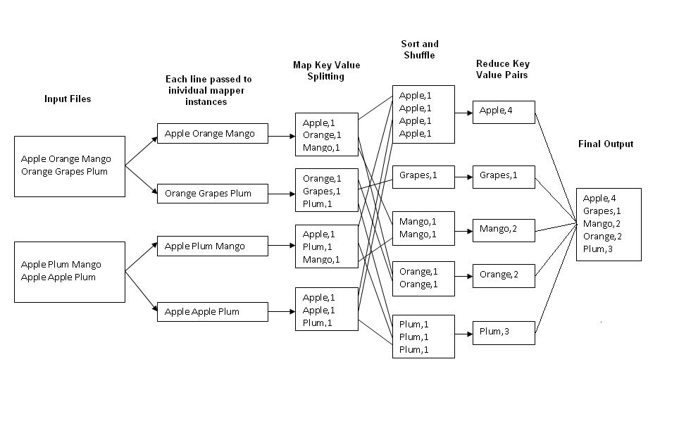
Example: Word Count
http://kickstarthadoop.blogspot.ca/2011/04/word-count-hadoop-map-reduce-example.html

Slide 60
MapReduce Programming Model

Slide 61
MapReduce programming model
MapReduce is only applicable for problems that can be broken down into independent sub-problems that just need to be joined afterwards.
Parallel/distributed processing to achieve speed-up of computations on huge data sets.
MapReduce programming model / paradigm:
Break input data into a number smaller chunks.
Carry out processing on each chunk in parallel and independent from other chunks and produce intermediary results based on that chunk only (map).
Move the job to where the data is stored: do processing on that node where the data is stored (i.e. one of the three associated GFS chunk servers).
Massive speed-up in comparison to traditional approaches with central storage.
Combine intermediary results into a final result (reduce).
Application developer needs to provide only corresponding map and reduce functions, the MapReduce infrastructure takes care of the rest

Slide 62
Programming with MapReduce
Determine if the problem is parallelizable and solvable using MapReduce (ex: do we need to deal with a large data set).
Design and implement solution as Mapper classes and Reducer class
Compile the source code with hadoop core
Package the code as jar executable
Configure the application (job) as to the number of mappers and reducers (tasks), input and output streams
Load the data (or use it on previously available data)
Launch the job and monitor
Study the result

Slide 63
MapReduce model - two steps
Real algorithms are typically a sequence of map-reduce steps
When the Programmer submitted his parallel processing procedures to MapReduce, he just need to definite two functions: Map and Reduce

Slide 64
Mapper
Reads in input pair <Key,Value>
Outputs a pair <K’, V’>
Let’s count number of each word in user queries (or Tweets/Blogs)
The input to the mapper will be <queryID, QueryText>:
<Q1,“The teacher went to the store. The store was closed; the store opens in the morning. The store opens at 9am.” >
The output would be:
<The, 1> <teacher, 1> <went, 1> <to, 1> <the, 1> <store,1> <the, 1> <store, 1> <was, 1> <closed, 1> <the, 1> <store,1> <opens, 1> <in, 1> <the, 1> <morning, 1> <the 1> <store, 1> <opens, 1> <at, 1> <9am, 1>

Slide 65
Reducer
Accepts the Mapper output, and aggregates values on the key
For our example, the reducer input would be:
<The, 1> <teacher, 1> <went, 1> <to, 1> <the, 1> <store, 1> <the, 1> <store, 1> <was, 1> <closed, 1> <the, 1> <store, 1> <opens,1> <in, 1> <the, 1> <morning, 1> <the 1> <store, 1> <opens, 1> <at, 1> <9am, 1>
The output would be:
<The, 6> <teacher, 1> <went, 1> <to, 1> <store, 3> <was, 1> <closed, 1> <opens, 1> <morning, 1> <at, 1> <9am, 1>

Slide 66
MapReduce
Hadoop
Program
fork
fork
fork
Master
assign
map
assign
reduce
Input Data
Output Data
Transfer peta-scale data through network
Worker
write
Output
File 0
local
write
Worker
Split 0
read
Split 1
Worker
Split 2
Output
File 1
Worker
Worker
remote
read,
sort
Map
Reduce

Slide 67
Mappers and Reducers
Need to handle more data? Just add more Mappers/Reducers!
No need to handle multithreaded code
Mappers and Reducers are typically single threaded and deterministic
Determinism allows for restarting of failed jobs
Mappers/Reducers run entirely independent of each other
In Hadoop, they run in separate JVMs

Slide 68
MapReduce Characteristics
Very large scale data: peta, exa bytes
Write once and read many data: allows for parallelism without mutexes
Map and Reduce are the main operations: simple code
All the map should be completed before reduce operation starts
Map and reduce operations are typically performed by the same physical processor
Number of map tasks and reduce tasks are configurable
Operations are provisioned near the data
Runtime takes care of splitting and moving data for operations
Special distributed file system

Slide 69
When mapreduce doesn’t fit
Not everything is a mapreduce
Sometimes you need more communication
other programming paradigms will be more useful

Slide 70
What’s so tricky about MapReduce?
What’s often tricky is figuring out how to write an algorithm as a series of map-reduce substeps
How and when do you parallelize?
When should you even try to do this? when should you use a different model?

Slide 71
Classes of problems “mapreducable”
Benchmark for comparing: Jim Gray’s challenge on data-intensive computing. Ex: “Sort”
Google uses it for wordcount, adwords, pagerank, indexing data.
Simple algorithms such as grep, text-indexing, reverse indexing
Bayesian classification: data mining domain
Facebook uses it for various operations: demographics
Financial services use it for analytics
Astronomy: Gaussian analysis for locating extra-terrestrial objects

Slide 72
MapReduce summary
MapReduce system mainly consists of three modules
Client
Master
Worker
The client is responsible for submitting parallel processing assignments composed by the users to master node;
Master node will automatically decompose user’s task into Map missions and Reduce missions, and delivered to worker nodes;
Worker nodes request to the master node for the work tasks
The distributed file system consisting of many worker nodes will be used for storing input and output data of MapReduce.

